Slide 1
Time Dilation

Slide 2
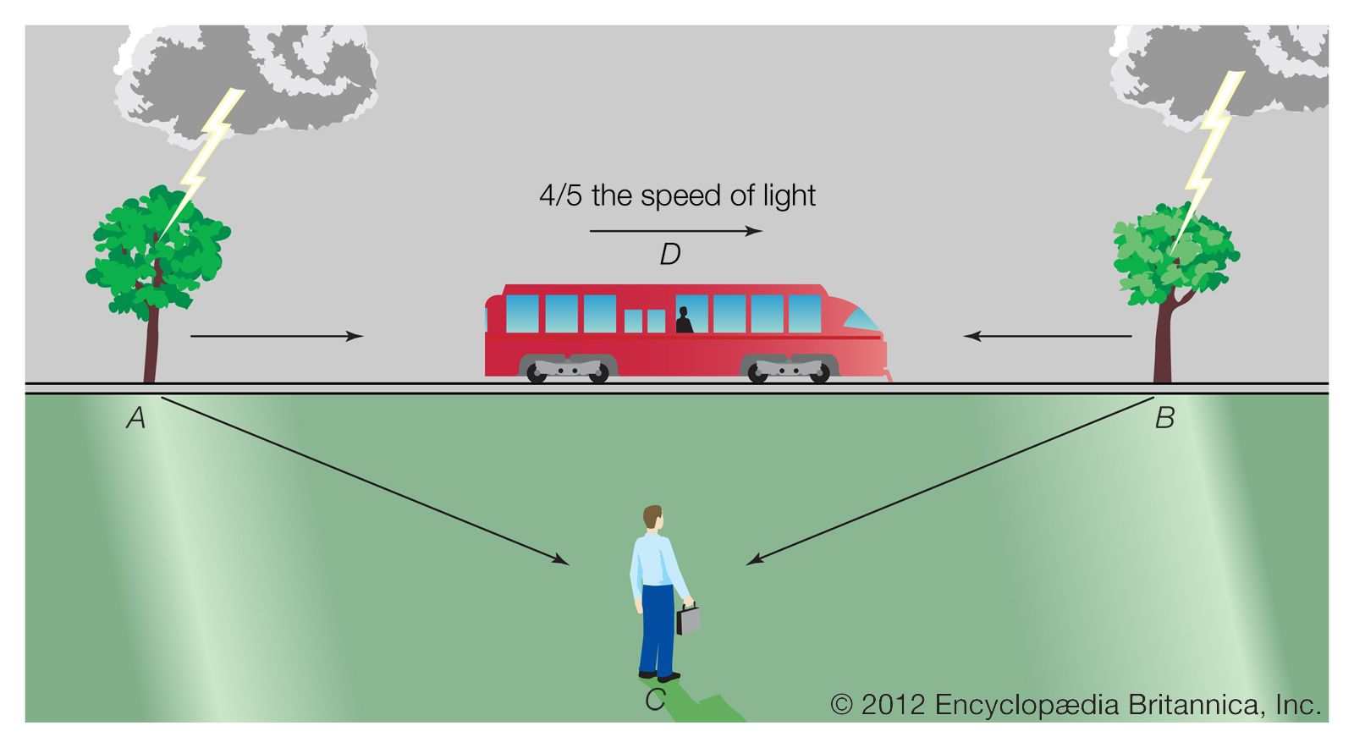
Relativity of Simultaneity Review
Since the speed of light does not change, events that are simultaneous in one frame of reference may happen at different times in another frame of reference.
Consider the train thought experiment involving the two strikes of lightning. Observer C (on the grass) sees strikes A and B happen at the same time.
However, in observer D’s frame of reference (on the train), strike B happens first – the light from strike A takes time to ‘catch up’ with the train.
Neither frame of reference is the ‘right’ one – remember, observer D thinks he is at rest!

Slide 3
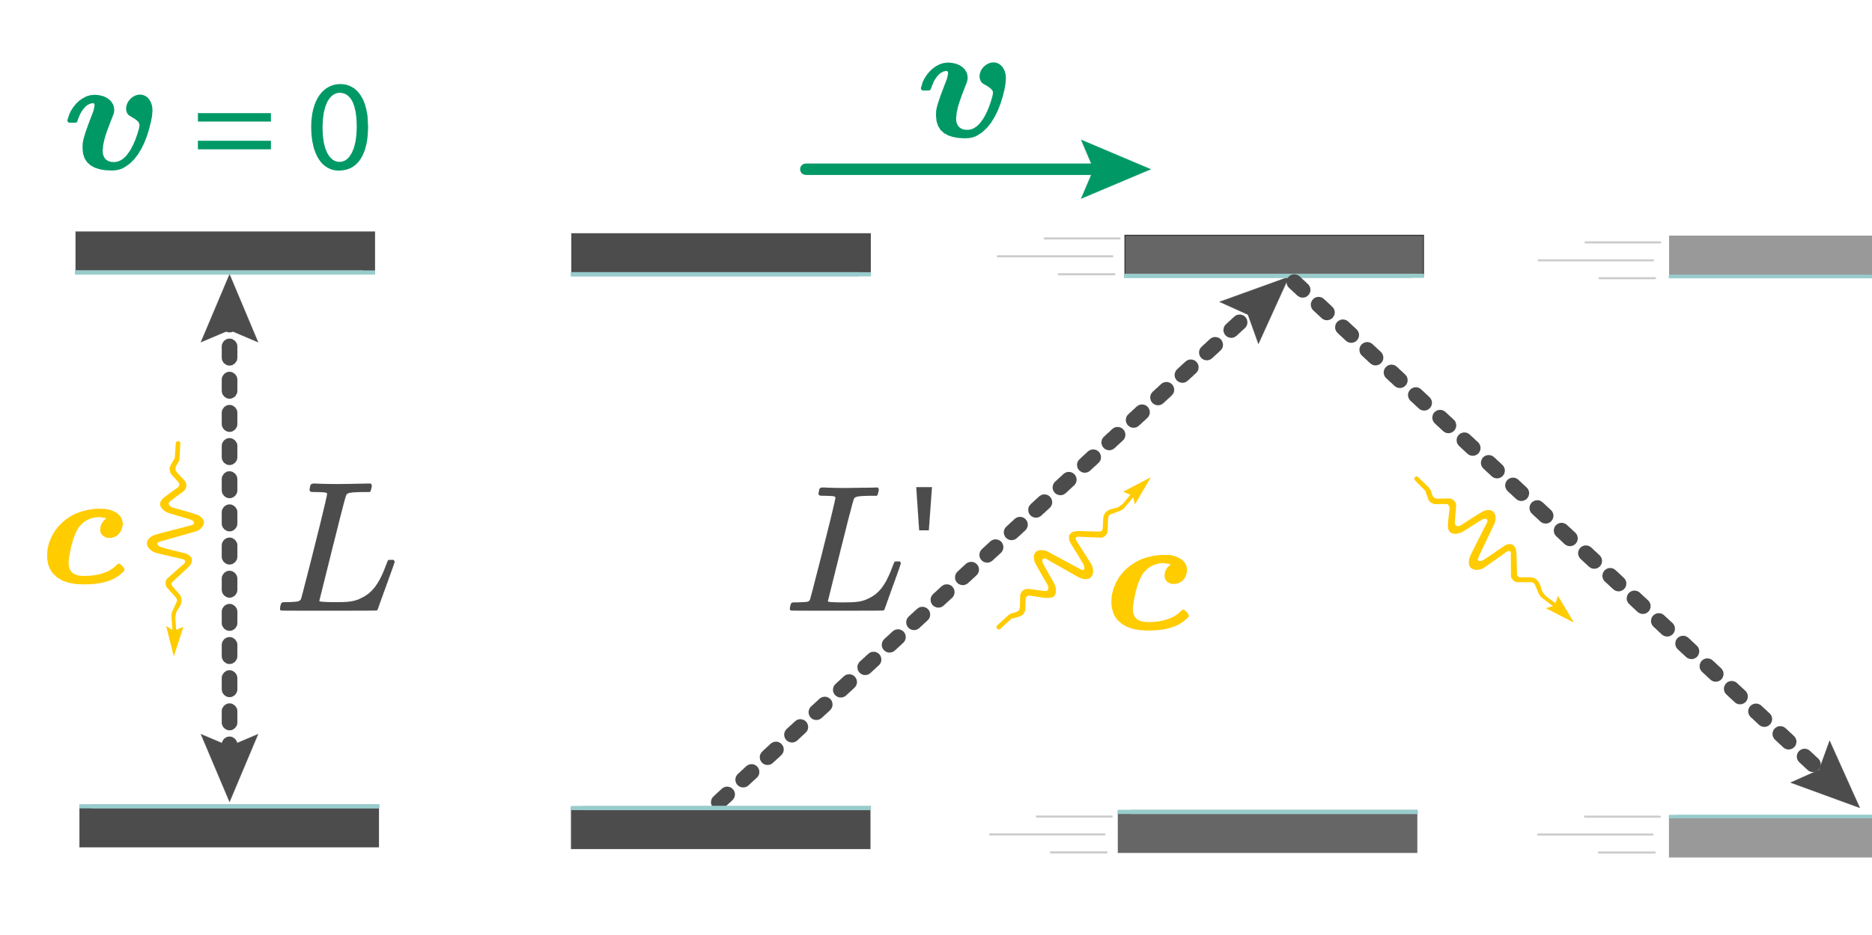
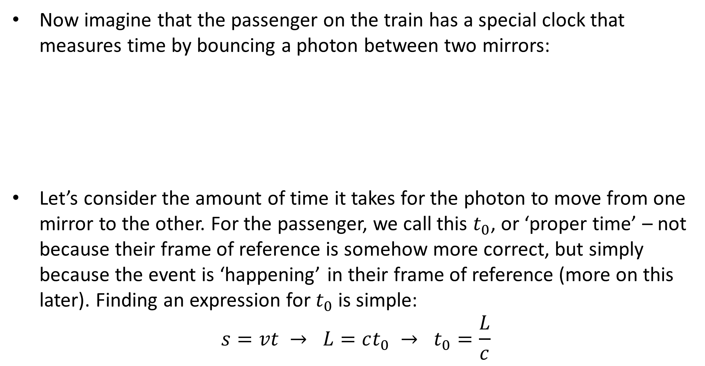
Time Dilation
Now imagine that the passenger on the train has a special clock that measures time by bouncing a photon between two mirrors:
Let’s consider the amount of time it takes for the photon to move from one mirror to the other. For the passenger, we call this $t_{0}$, or ‘proper time’ – not because their frame of reference is somehow more correct, but simply because the event is ‘happening’ in their frame of reference (more on this later). Finding an expression for $t_{0}$ is simple:
$$s=vt → L=ct_{0} → t_{0}=\frac{L}{c}$$

Slide 4
Time Dilation
But remember, this train is travelling at 0.8c. What would an observer outside of the train see?
Because the train and mirror are moving (relative to the external observer), in their frame of reference the photon travels a greater distance.
c, however, remains the same in all frames of reference, so if L changes then t must change. Put simply, the photon needs more time to travel the increased distance – so the external observer sees the clock running slower.
This is true at all speeds, but not noticeable at common speeds.

Slide 5
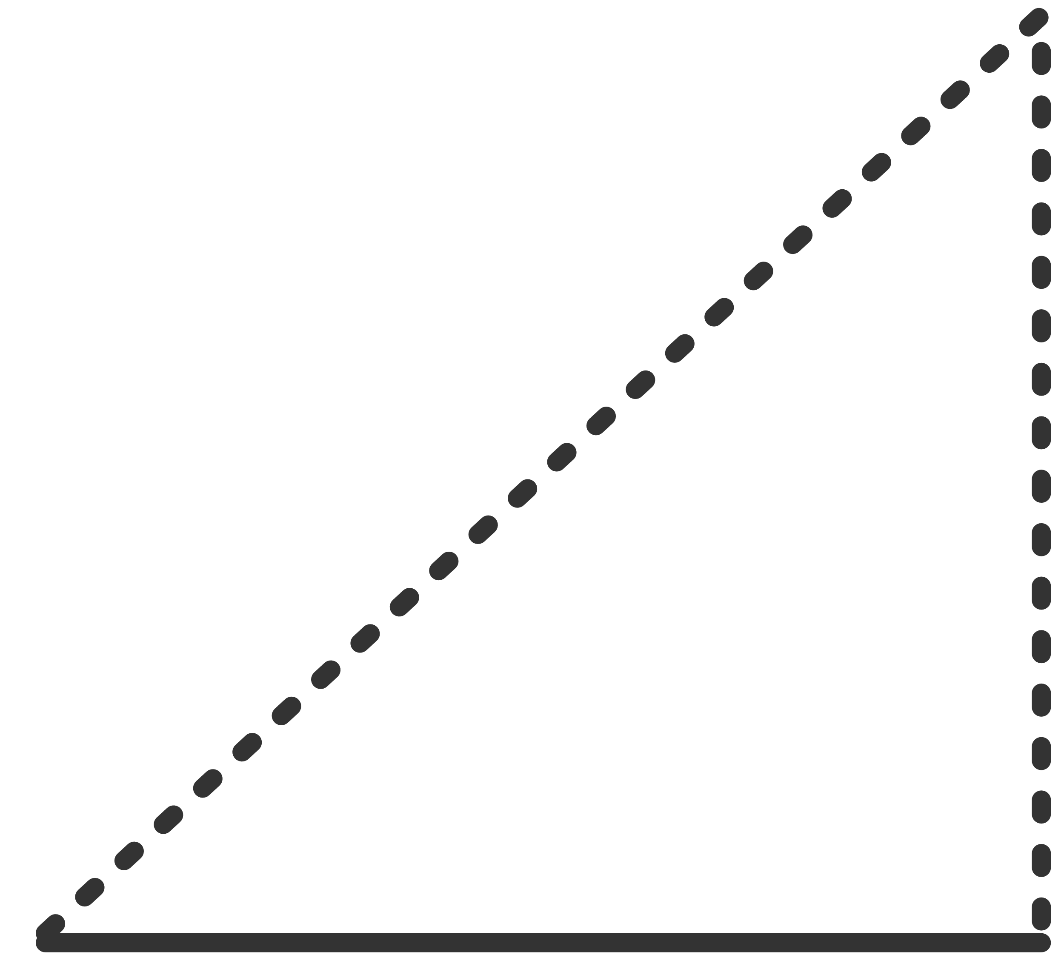

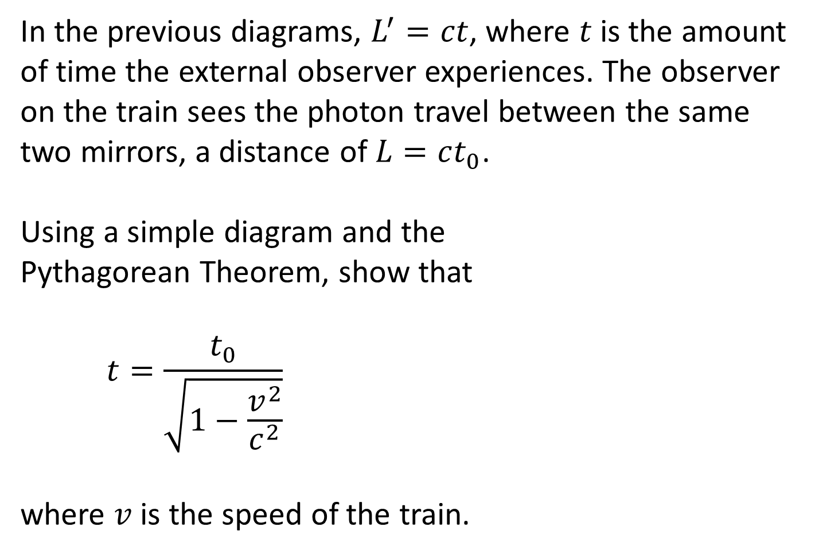


Example #1
In the previous diagrams, $L^{′}=ct$, where $t$ is the amount of time the external observer experiences. The observer on the train sees the photon travel between the same two mirrors, a distance of $L=ct_{0}$.
Using a simple diagram and the Pythagorean Theorem, show that
$$t=\frac{t_{0}}{\sqrt{1−\frac{v^{2}}{c^{2}}}}$$
where $v$ is the speed of the train.
$$ct$$
$$ct_{0}$$
$$vt$$

Slide 6

Example #1
From the diagram:
$${\left(ct\right)}^{2}={\left(ct_{0}\right)}^{2}+{\left(vt\right)}^{2}$$
$$c^{2}t^{2}−v^{2}t^{2}=c^{2}{t_{0}}^{2}$$
$$\left(c^{2}−v^{2}\right)t^{2}=c^{2}{t_{0}}^{2}$$
$$t^{2}=\frac{c^{2}{t_{0}}^{2}}{c^{2}−v^{2}}$$

Slide 7

Example #1
$$t^{2}=\frac{c^{2}{t_{0}}^{2}}{c^{2}−v^{2}}$$
Divide the numerator and denominator by $c^{2}$:
$$t^{2}=\frac{{t_{0}}^{2}}{1−\frac{v^{2}}{c^{2}}}$$
Take the square root of both sides:
$$t=\frac{t_{0}}{\sqrt{1−\frac{v^{2}}{c^{2}}}}$$

Slide 8
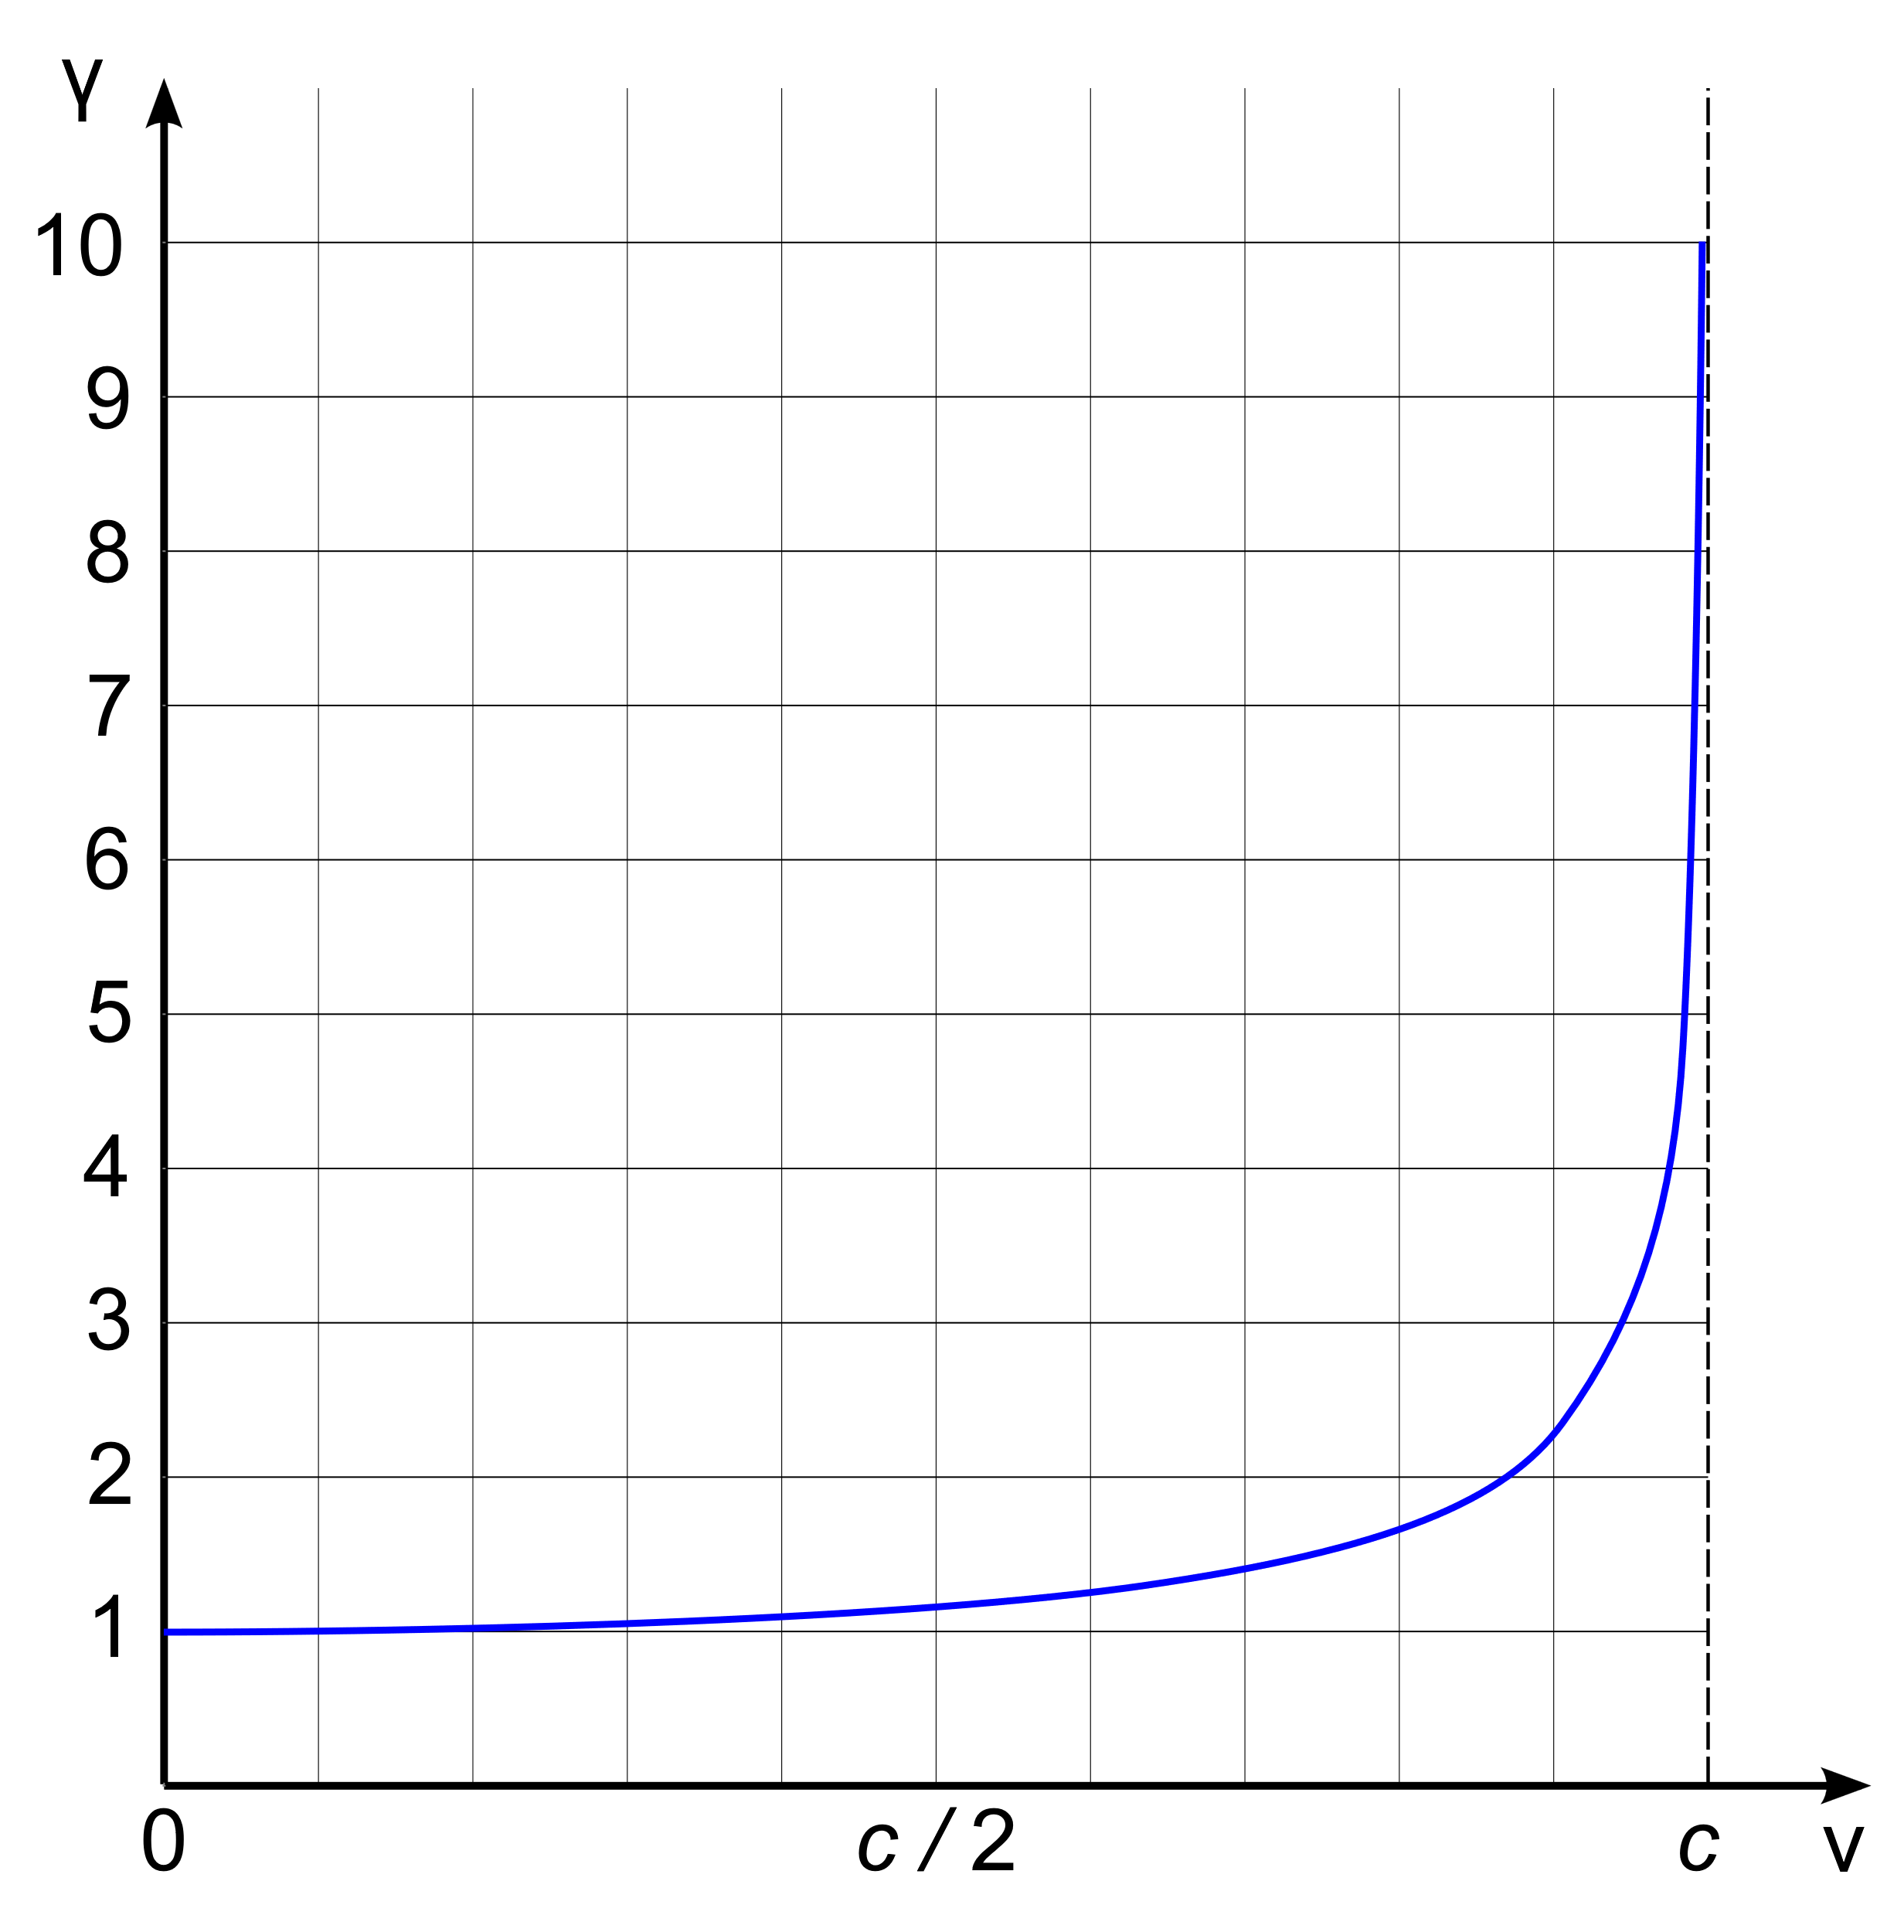
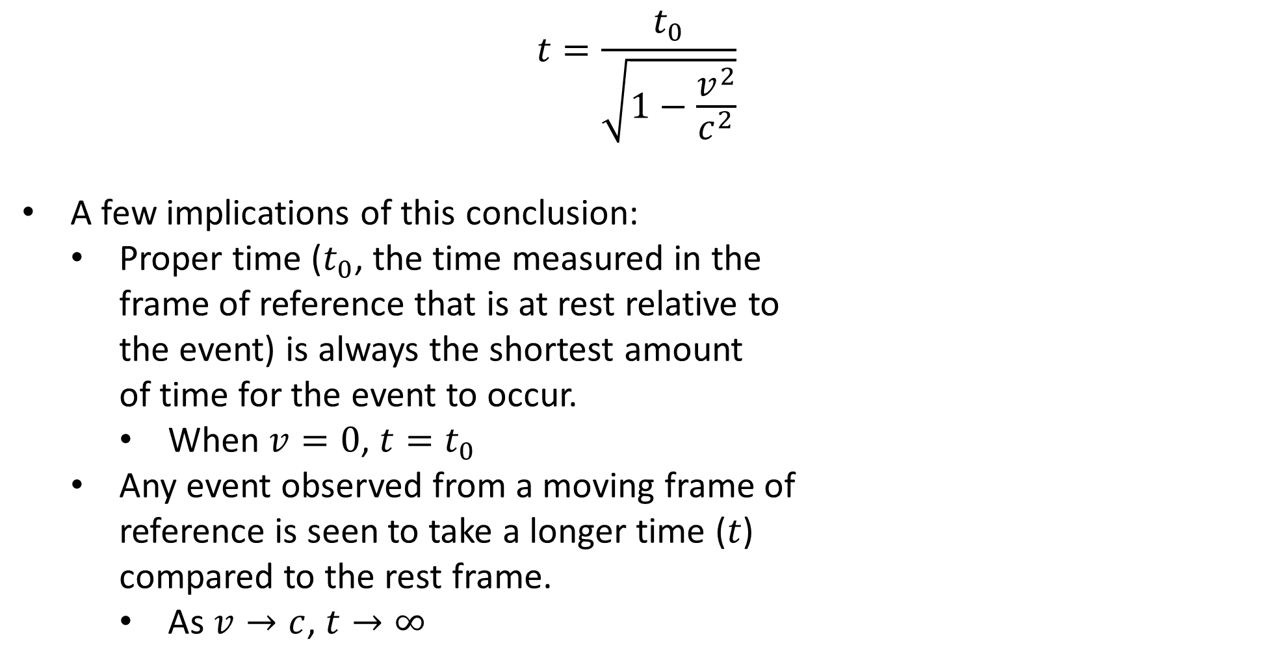
Time Dilation
$$t=\frac{t_{0}}{\sqrt{1−\frac{v^{2}}{c^{2}}}}$$
A few implications of this conclusion:
Proper time ($t_{0}$, the time measured in the frame of reference that is at rest relative to the event) is always the shortest amount of time for the event to occur.
When $v=0$, $t=t_{0}$
Any event observed from a moving frame of reference is seen to take a longer time ($t$) compared to the rest frame.
As $v→c$, $t→∞$
Notes:
$$γ=\frac{1}{\sqrt{1−\frac{v^{2}}{c^{2}}}}$$
Still confused? A great (if somewhat lengthy) video on this topic and some of the evidence behind it can be found at https://youtu.be/qSjwPeyDa2Y

Slide 9
